Slide 1





Random Data Generation and Visualization
ChatGPT – Python (Jupyter Notebook)
Amirul Ikhwan Faizi

Slide 2

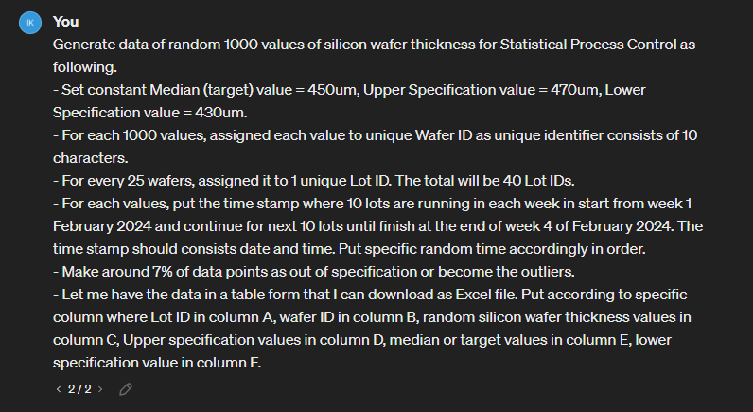
Prompt to generate 1000 data points of silicon wafer thickness
Amirul Ikhwan Faizi
2

Slide 3
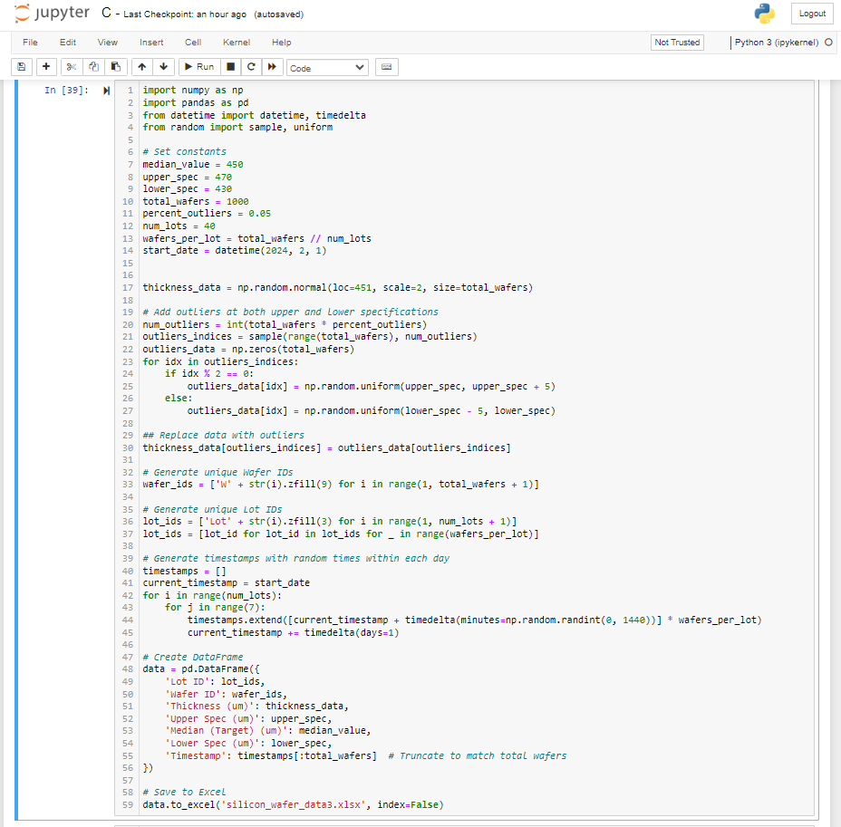
Python code of data generation
Amirul Ikhwan Faizi
3

Slide 4
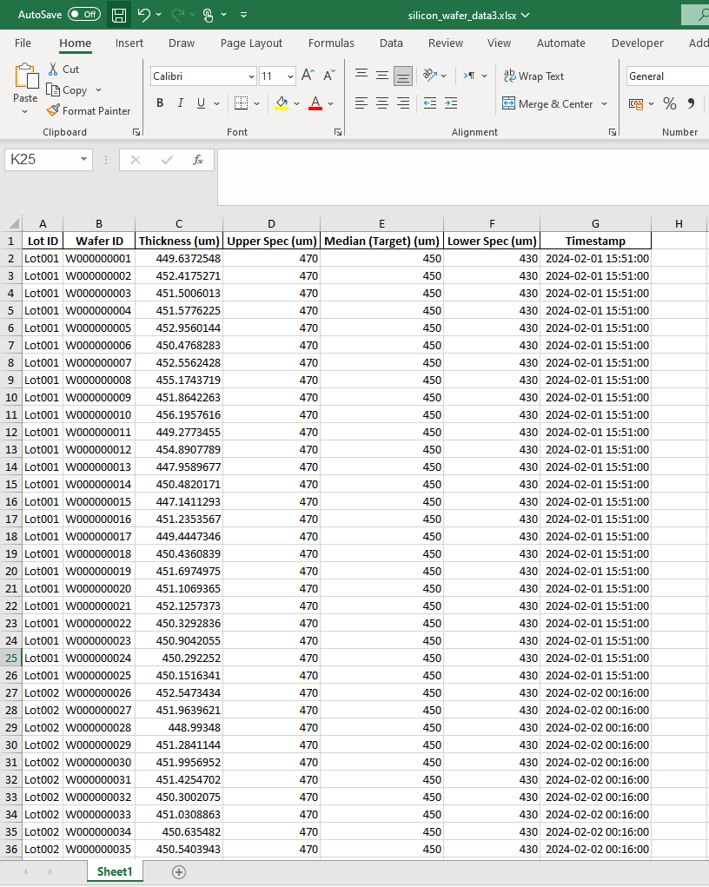
Generated data in Excel file
Amirul Ikhwan Faizi
4

Slide 5
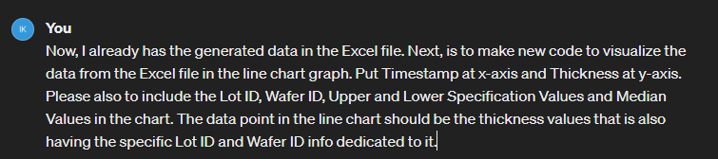
Prompt to visualize data in line chart form
Amirul Ikhwan Faizi
5

Slide 6
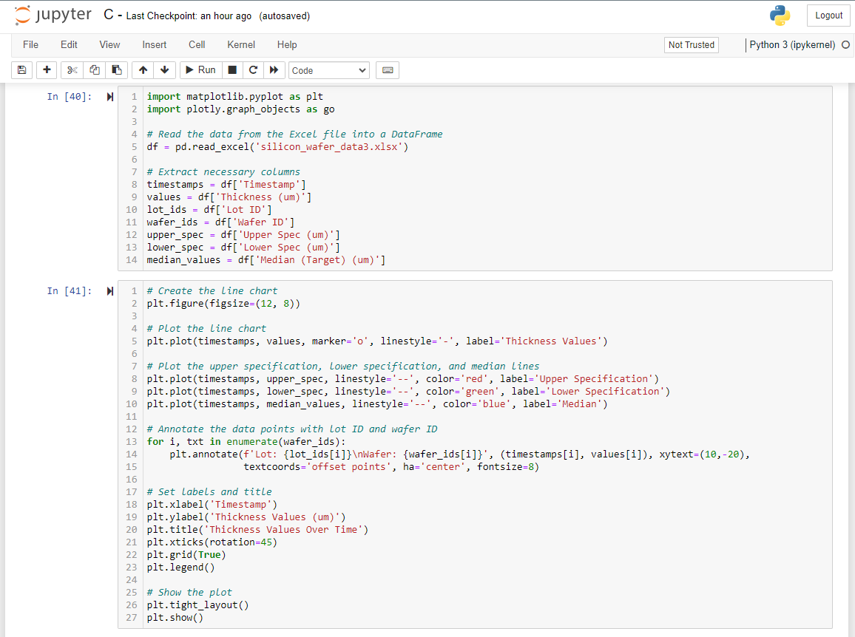
Python code to plot data in line chart
Amirul Ikhwan Faizi
6

Slide 7
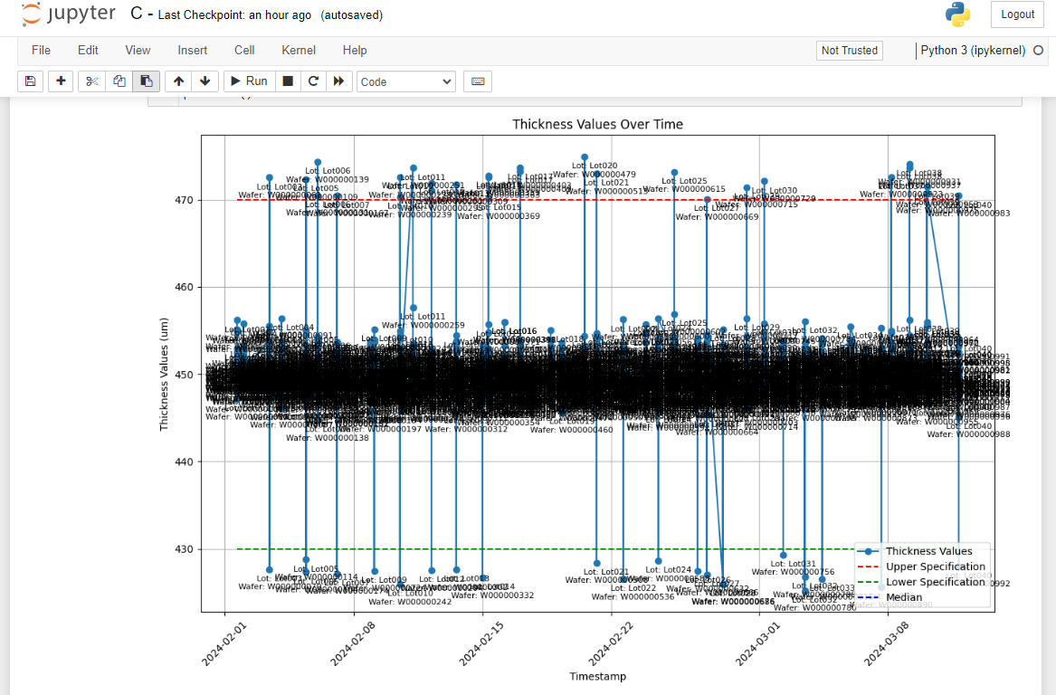
Python code result for line chart plotting
Amirul Ikhwan Faizi
7

Slide 8
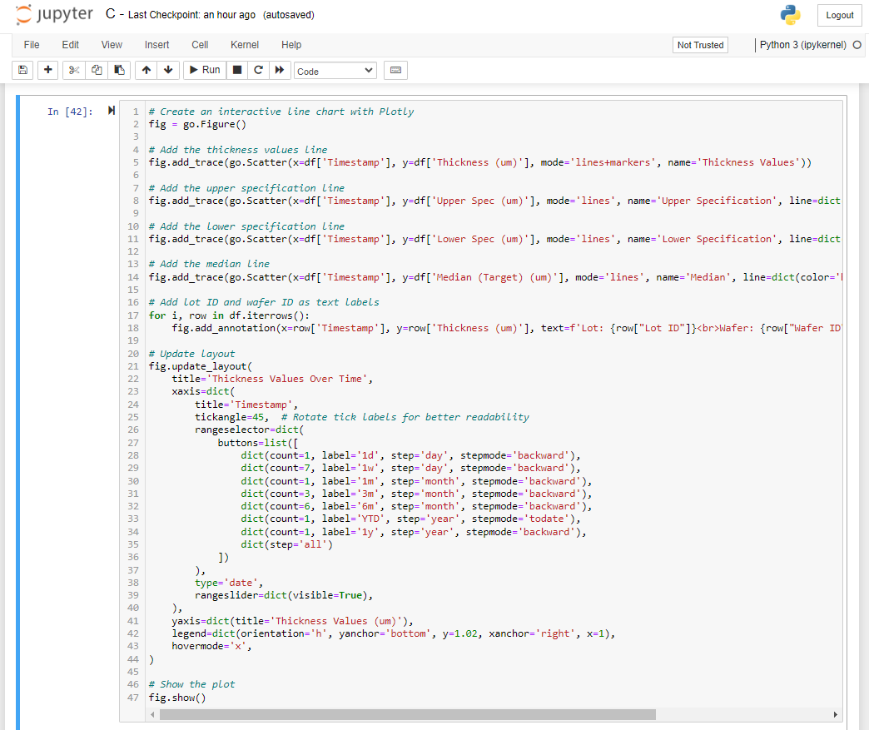
Python code to plot data in line chart – but, using Plotly library
Amirul Ikhwan Faizi
8

Slide 9
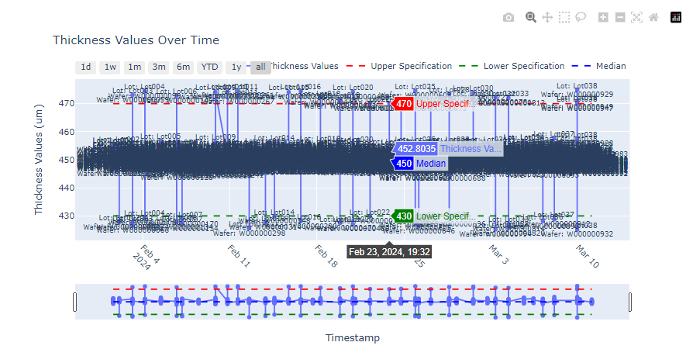
Python code result for line chart plotting – Plotly library
Amirul Ikhwan Faizi
9

Slide 10
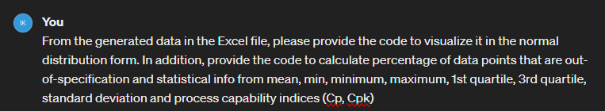
Prompt to visualize data in normal distribution form and calculation of several statistical measures
Amirul Ikhwan Faizi
10

Slide 11
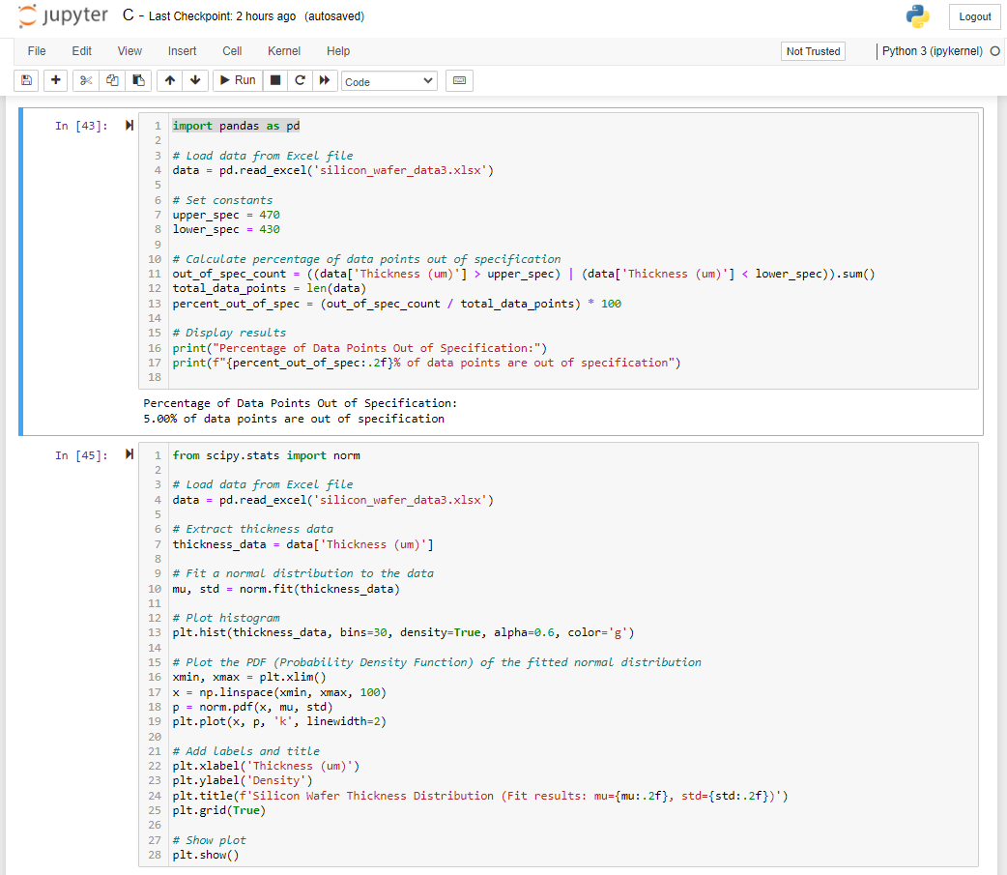
Python code result for visualizing normal distribution and doing some calculations
Amirul Ikhwan Faizi
11

Slide 12
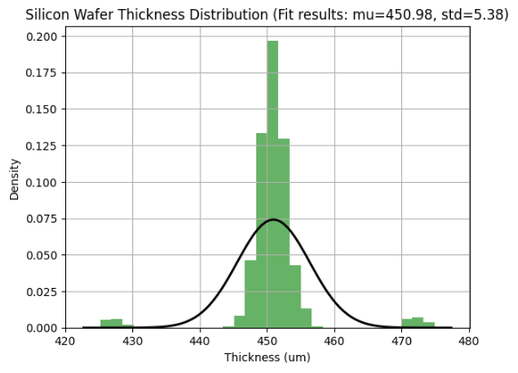
Python code result for normal distribution
Amirul Ikhwan Faizi
12

Slide 13
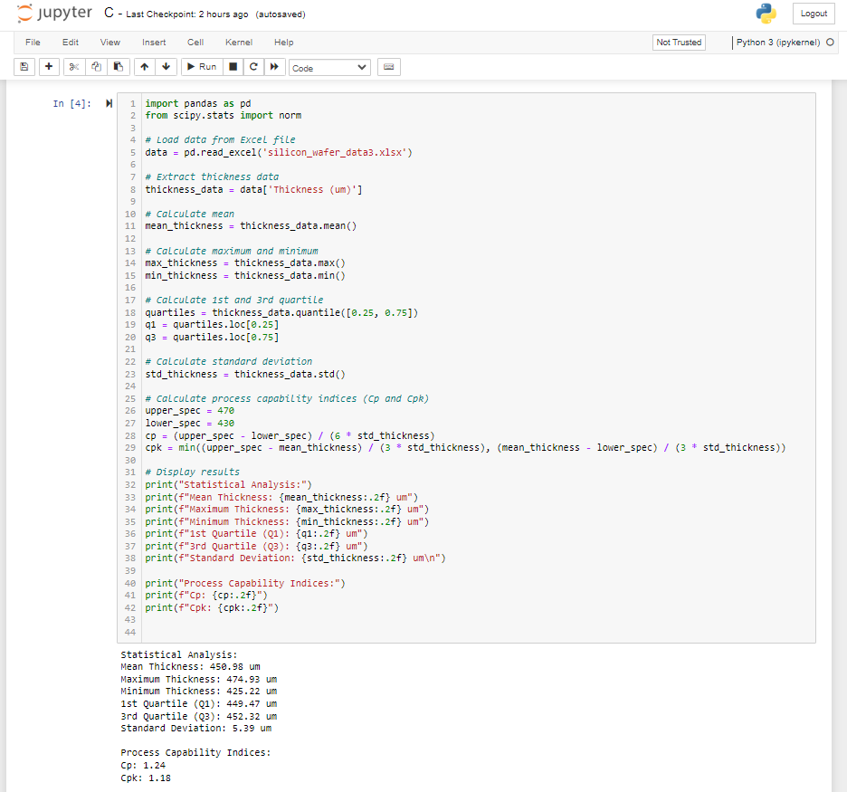
Python code for statistical calculation and its result
Amirul Ikhwan Faizi
13

Slide 14
Thank You
Amirul Ikhwan Faizi

